Slide 1
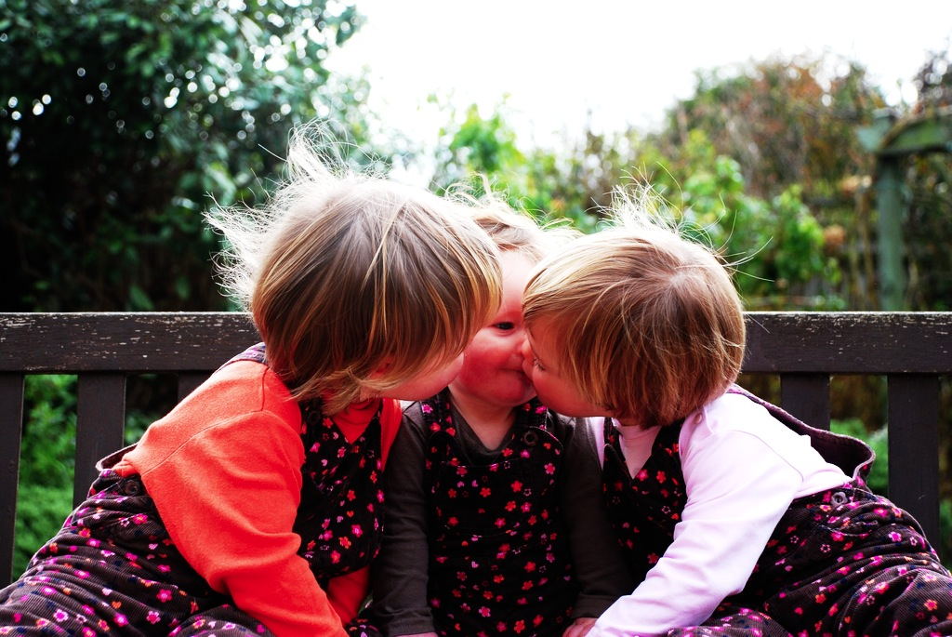

Intention and
Motor Representation
in Joint Action

Slide 2
tidying up the toys together
(Behne et al 2005)
cooperatively pulling handles in sequence to make a dog-puppet sing
(Brownell et al 2006)
bouncing a ball on a large trampoline together
(Tomasello & Carpenter 2007)
pretending to row a boat together
Notes:
Two challenges : (1) fit intuitive category; (2) explain the contrast cases

Slide 3
painting a house together
(Bratman 1992)
lifting a heavy sofa together
(Velleman 1997)
preparing a hollandaise sauce together
(Searle 1990)
going to Chicago together
(Kutz 2000)
walking together
(Gilbert 1990)
tidying up the toys together
(Behne et al 2005)
cooperatively pulling handles in sequence to make a dog-puppet sing
(Brownell et al 2006)
bouncing a ball on a large trampoline together
(Tomasello & Carpenter 2007)
pretending to row a boat together
Notes:
These anchor our understanding of what joint action is.

Slide 4
Joint
Not joint

Slide 5
Joint
Not joint
Jack and Sue walk together
Jack and Sue walk alongside each other
(Gilbert 1990)

Slide 6
Joint
Not joint
Jack and Sue walk together
Jack and Sue walk alongside each other
(Gilbert 1990)
We collectively perform a dance by running to a shelter at the same time
We each individually run to a shelter at the same time (in response to a sudden shower).
(Searle 1990, 92)

Slide 7
exoticism
Notes:
exoticism is the thesis that distinctive ingredients are needed to characterise joint action.

Slide 8
‘The key question in the philosophy of collective action is simply ... under what conditions are two or more people doing something together?’
(Gilbert 2010: 67)
Notes:
exoticism is the thesis that distinctive ingredients are needed to characterise joint action.

Slide 9
shared intention

Slide 10
‘I take a collective action to involve a collective [shared] intention.’
(Gilbert 2006, p. 5)

Slide 11
‘I take a collective action to involve a collective [shared] intention.’
(Gilbert 2006, p. 5)
‘The sine qua non of collaborative action is a joint goal [shared intention] and a joint commitment’
(Tomasello 2008, p. 181)

Slide 12
‘I take a collective action to involve a collective [shared] intention.’
(Gilbert 2006, p. 5)
‘The sine qua non of collaborative action is a joint goal [shared intention] and a joint commitment’
(Tomasello 2008, p. 181)
‘the key property of joint action lies in its internal component [...] in the participants’ having a “collective” or “shared” intention.’
(Alonso 2009, pp. 444-5)
‘Shared intentionality is the foundation upon which joint action is built.’
(Carpenter 2009, p. 381)

Slide 13
Joint action:
an action with two or more agents (Ludwig 2007)

Slide 14
Joint action:
an action with two or more agents (Ludwig 2007)

Slide 15
Joint action:
an action with two or more agents (Ludwig 2007)
‘our primitive actions, the ones we do not by doing something else, ... these are all the actions there are.’ (Davidson 1971, p. 59).

Slide 16
Joint action:
an action with two or more agents (Ludwig 2007)
‘our primitive actions, the ones we do not by doing something else, ... these are all the actions there are.’ (Davidson 1971, p. 59).
move fingers
unlock door
turn key

Slide 17
Joint action:
an action with two or more agents (Ludwig 2007)
‘our primitive actions, the ones we do not by doing something else, ... these are all the actions there are.’ (Davidson 1971, p. 59).
move fingers
unlock door
turn key

Slide 18
Joint action:
an action with two or more agents (Ludwig 2007)
‘our primitive actions, the ones we do not by doing something else, ... these are all the actions there are.’ (Davidson 1971, p. 59).
move fingers
unlock door
turn key

Slide 19
Joint action:
an action with two or more agents (Ludwig 2007)
‘our primitive actions, the ones we do not by doing something else, ... these are all the actions there are.’ (Davidson 1971, p. 59).
tidying up the toys together
(Behne et al 2005)
cooperatively pulling handles in sequence to make a dog-puppet sing
(Brownell et al 2006)
bouncing a ball on a large trampoline together
(Tomasello & Carpenter 2007)
pretending to row a boat together
move fingers
unlock door
turn key

Slide 20
Joint action:
an action with two or more agents (Ludwig 2007)
‘our primitive actions, the ones we do not by doing something else, ... these are all the actions there are.’ (Davidson 1971, p. 59).
tidying up the toys together
(Behne et al 2005)
cooperatively pulling handles in sequence to make a dog-puppet sing
(Brownell et al 2006)
bouncing a ball on a large trampoline together
(Tomasello & Carpenter 2007)
pretending to row a boat together
move fingers
unlock door
turn key

Slide 21
Joint action:
an action with two or more agents (Ludwig 2007)
tidying up the toys together
(Behne et al 2005)
cooperatively pulling handles in sequence to make a dog-puppet sing
(Brownell et al 2006)
bouncing a ball on a large trampoline together
(Tomasello & Carpenter 2007)
pretending to row a boat together
my pulling
dog’s singing
your pulling
We make the dog sing

Slide 22
Joint action:
an action with two or more agents (Ludwig 2007)
tidying up the toys together
(Behne et al 2005)
cooperatively pulling handles in sequence to make a dog-puppet sing
(Brownell et al 2006)
bouncing a ball on a large trampoline together
(Tomasello & Carpenter 2007)
pretending to row a boat together
my pulling
dog’s singing
your pulling
We make the dog sing

Slide 23
1
Joint action:
an action with two or more agents (Ludwig 2007)
Bodily movements ‘are all the actions there are’ (Davidson 1971, p. 59)
In supposedly paradigm cases of joint action, there are no bodily movements with more than one agent.
Therefore:
Supposedly paradigm cases are not joint actions.
tidying up the toys together
(Behne et al 2005)
cooperatively pulling handles in sequence to make a dog-puppet sing
(Brownell et al 2006)
bouncing a ball on a large trampoline together
(Tomasello & Carpenter 2007)
pretending to row a boat together
2
3
4

Slide 24
1
too narrow
Joint action:
an action with two or more agents (Ludwig 2007)
Bodily movements ‘are all the actions there are’ (Davidson 1971, p. 59)
In supposedly paradigm cases of joint action, there are no bodily movements with more than one agent.
Therefore:
Supposedly paradigm cases are not joint actions.
tidying up the toys together
(Behne et al 2005)
cooperatively pulling handles in sequence to make a dog-puppet sing
(Brownell et al 2006)
bouncing a ball on a large trampoline together
(Tomasello & Carpenter 2007)
pretending to row a boat together
2
3
4

Slide 25
?
1
too narrow
Joint action:
an action with two or more agents (Ludwig 2007)
Bodily movements ‘are all the actions there are’ (Davidson 1971, p. 59)
In supposedly paradigm cases of joint action, there are no bodily movements with more than one agent.
Therefore:
Supposedly paradigm cases are not joint actions.
tidying up the toys together
(Behne et al 2005)
cooperatively pulling handles in sequence to make a dog-puppet sing
(Brownell et al 2006)
bouncing a ball on a large trampoline together
(Tomasello & Carpenter 2007)
pretending to row a boat together
2
3
4

Slide 26
?
1
too narrow
Joint action:
an action with two or more agents (Ludwig 2007)
Bodily movements ‘are all the actions there are’ (Davidson 1971, p. 59)
In supposedly paradigm cases of joint action, there are no bodily movements with more than one agent.
Therefore:
Supposedly paradigm cases are not joint actions.
tidying up the toys together
(Behne et al 2005)
cooperatively pulling handles in sequence to make a dog-puppet sing
(Brownell et al 2006)
bouncing a ball on a large trampoline together
(Tomasello & Carpenter 2007)
pretending to row a boat together
2
3
4
Notes:
we could reject this ... but I want to pursue a different approach

Slide 27
1
too narrow
Joint action:
an action with two or more agents (Ludwig 2007)
Bodily movements ‘are all the actions there are’ (Davidson 1971, p. 59)
In supposedly paradigm cases of joint action, there are no bodily movements with more than one agent.
Therefore:
Supposedly paradigm cases are not joint actions.
tidying up the toys together
(Behne et al 2005)
cooperatively pulling handles in sequence to make a dog-puppet sing
(Brownell et al 2006)
bouncing a ball on a large trampoline together
(Tomasello & Carpenter 2007)
pretending to row a boat together
2
3
4
Notes:
we could reject this ... but I want to pursue a different approach

Slide 28
Joint action:
an action with two or more agents (Ludwig 2007)

Slide 29
Joint action:
an action event with two or more agents (Ludwig 2007)

Slide 30
Grounding
events D₁, ... D_{n} ground E, if:
D₁, ... D_{n} and E occur;
D₁, ... D_{n} are each (perhaps improper) parts of E; and
every event that is a proper part of E but does not overlap D₁,...D_{n} is caused by some or all of D₁, ... D_{n}.
Agency
For an individual to be among the agents of an event is for there to be actions a₁, ... a_{n} which ground this event where the individual is an agent of one or more of these actions.
(Adapted from Pietroski 1998)

Slide 31
Joint action:
an action event with two or more agents (Ludwig 2007)

Slide 32
Joint action:
an action event with two or more agents (Ludwig 2007)
tidying up the toys together
(Behne et al 2005)
cooperatively pulling handles in sequence to make a dog-puppet sing
(Brownell et al 2006)
bouncing a ball on a large trampoline together
(Tomasello & Carpenter 2007)
pretending to row a boat together
my pulling
dog’s singing
your pulling
We make the dog sing

Slide 33
Joint action:
an action event with two or more agents (Ludwig 2007)
tidying up the toys together
(Behne et al 2005)
cooperatively pulling handles in sequence to make a dog-puppet sing
(Brownell et al 2006)
bouncing a ball on a large trampoline together
(Tomasello & Carpenter 2007)
pretending to row a boat together

Slide 34
Joint action:
an action event with two or more agents (Ludwig 2007)
tidying up the toys together
(Behne et al 2005)
cooperatively pulling handles in sequence to make a dog-puppet sing
(Brownell et al 2006)
bouncing a ball on a large trampoline together
(Tomasello & Carpenter 2007)
pretending to row a boat together
Nora’s shooting
Fred’s death
Olive’s shooting
Fred’s killing

Slide 35
too broad
Joint action:
an action event with two or more agents (Ludwig 2007)
tidying up the toys together
(Behne et al 2005)
cooperatively pulling handles in sequence to make a dog-puppet sing
(Brownell et al 2006)
bouncing a ball on a large trampoline together
(Tomasello & Carpenter 2007)
pretending to row a boat together
Nora’s shooting
Fred’s death
Olive’s shooting
Fred’s killing

Slide 36
too broad
Joint action:
an action event with two or more agents (Ludwig 2007)
tidying up the toys together
(Behne et al 2005)
cooperatively pulling handles in sequence to make a dog-puppet sing
(Brownell et al 2006)
bouncing a ball on a large trampoline together
(Tomasello & Carpenter 2007)
pretending to row a boat together
Nora’s shooting
Fred’s death
Olive’s shooting
Fred’s killing

Slide 37
Goal-directed joint action: an event with two or more agents which, taken as a whole, is directed to a goal.
tidying up the toys together
(Behne et al 2005)
cooperatively pulling handles in sequence to make a dog-puppet sing
(Brownell et al 2006)
bouncing a ball on a large trampoline together
(Tomasello & Carpenter 2007)
pretending to row a boat together
Nora’s shooting
Fred’s death
Olive’s shooting
Fred’s killing

Slide 38
Goal-directed joint action: an event with two or more agents which, taken as a whole, is directed to a goal.
tidying up the toys together
(Behne et al 2005)
cooperatively pulling handles in sequence to make a dog-puppet sing
(Brownell et al 2006)
bouncing a ball on a large trampoline together
(Tomasello & Carpenter 2007)
pretending to row a boat together
cooperatively pulling handles in sequence to make a dog-puppet sing
(Brownell et al 2006)
my pulling
dog’s singing
your pulling
We make the dog sing

Slide 39
Goal-directed joint action: an event with two or more agents which, taken as a whole, is directed to a goal.
out
out
act
out
act
out

Slide 40
Goal-directed joint action: an event with two or more agents which, taken as a whole, is directed to a goal.
out
out
act
represents
coordinates
out
act
shared intention
out

Slide 41
Goal-directed joint action: an event with two or more agents which, taken as a whole, is directed to a goal.
???
out
out
act
represents
coordinates
out
act
shared intention
out

Slide 42
Detour
Goals are not intentions

Slide 43
What is the relation between an action and the goal (or goals) to which it is directed?
out
out
act
out
out

Slide 44
What is the relation between an action and the goal (or goals) to which it is directed?
out
out
act
out
out

Slide 45
What is the relation between an action and the goal (or goals) to which it is directed?
out
out
act
out
intention or other goal-state
out

Slide 46
What is the relation between an action and the goal (or goals) to which it is directed?
teleological function
out
out
act
out
intention or other goal-state
out

Slide 47
(i) in the past, actions of this type have caused outcomes of this type; (ii) this action happens now in part because (i).
What is the relation between an action and the goal (or goals) to which it is directed?
teleological function
out
out
act
out
intention or other goal-state
out

Slide 48
(i) in the past, actions of this type have caused outcomes of this type; (ii) this action happens now in part because (i).
What is the relation between an action and the goal (or goals) to which it is directed?
teleological function
out
out
act
out
intention or other goal-state
It is possible to represent goal-directed actions without representing intentions.
out

Slide 49
End Detour

Slide 50
Goal-directed joint action: an event with two or more agents which, taken as a whole, is directed to a goal.
???
out
out
act
represents
coordinates
out
act
shared intention
out

Slide 51
Goal-directed joint action: an event with two or more agents which, taken as a whole, is directed to a goal.
G is a distributive goal: it is an outcome to which each agent’s activities are individually directed and it is possible that: all agents succeed relative to this outcome.

Slide 52
Goal-directed joint action: an event with two or more agents which, taken as a whole, is directed to a goal.
G is a distributive goal: it is an outcome to which each agent’s activities are individually directed and it is possible that: all agents succeed relative to this outcome.
G is a collective goal
(a) it is a distributive goal;
(b) the agents’ activities are coordinated; and
(c) coordination of this type would normally facilitate occurrences of outcomes of this type.

Slide 53
Goal-directed joint action: an event with two or more agents which, taken as a whole, is directed to a goal.
G is a distributive goal: it is an outcome to which each agent’s activities are individually directed and it is possible that: all agents succeed relative to this outcome.
G is a collective goal
(a) it is a distributive goal;
(b) the agents’ activities are coordinated; and
(c) coordination of this type would normally facilitate occurrences of outcomes of this type.

Slide 54
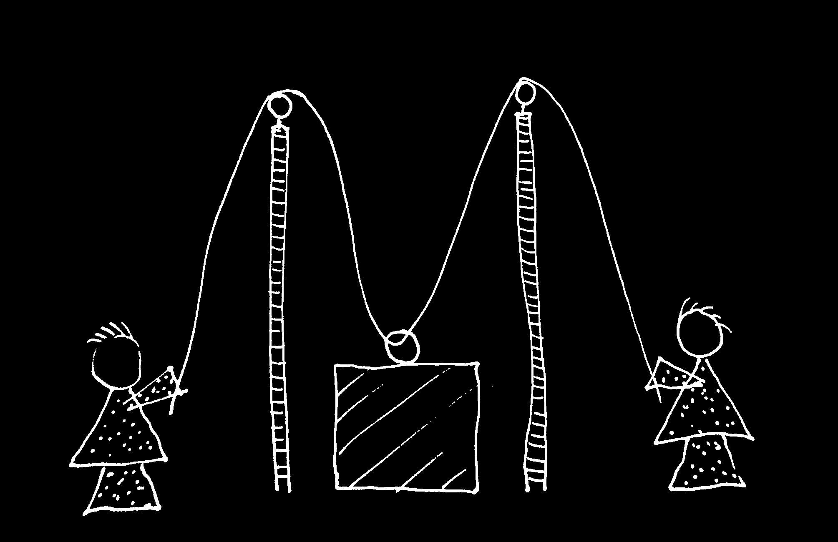

Slide 55
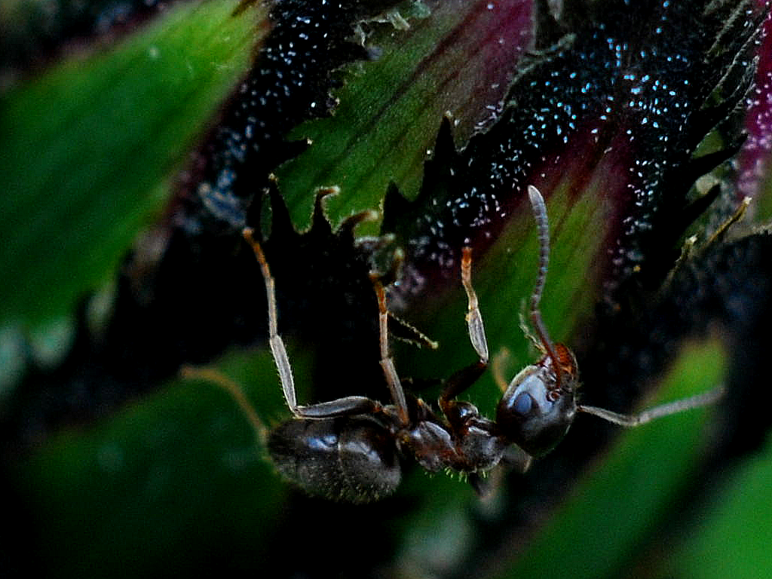

Slide 56
sting
sting
sting
sting
sting
death of fly
sting
sting
sting

Slide 57
Goal-directed joint action: an event with two or more agents which, taken as a whole, is directed to a goal.
G is a distributive goal: it is an outcome to which each agent’s activities are individually directed and it is possible that: all agents succeed relative to this outcome.
G is a collective goal
(a) it is a distributive goal;
(b) the agents’ activities are coordinated; and
(c) coordination of this type would normally facilitate occurrences of outcomes of this type.

Slide 58
Goal-directed joint action: an event with two or more agents which, taken as a whole, is directed to a goal.
G is a distributive goal: it is an outcome to which each agent’s activities are individually directed and it is possible that: all agents succeed relative to this outcome.
G is a shared goal
G is a collective goal
(a) it is a distributive goal;
(b) the agents’ activities are coordinated; and
(c) coordination of this type would normally facilitate occurrences of outcomes of this type.
Each agent expects each of the other agents to perform activities directed to the goal.
Each agent expects the goal to occur as a common effect of all their goal-directed actions.

Slide 59
Joint action:
an action event with two or more agents (Ludwig 2007)

Slide 60
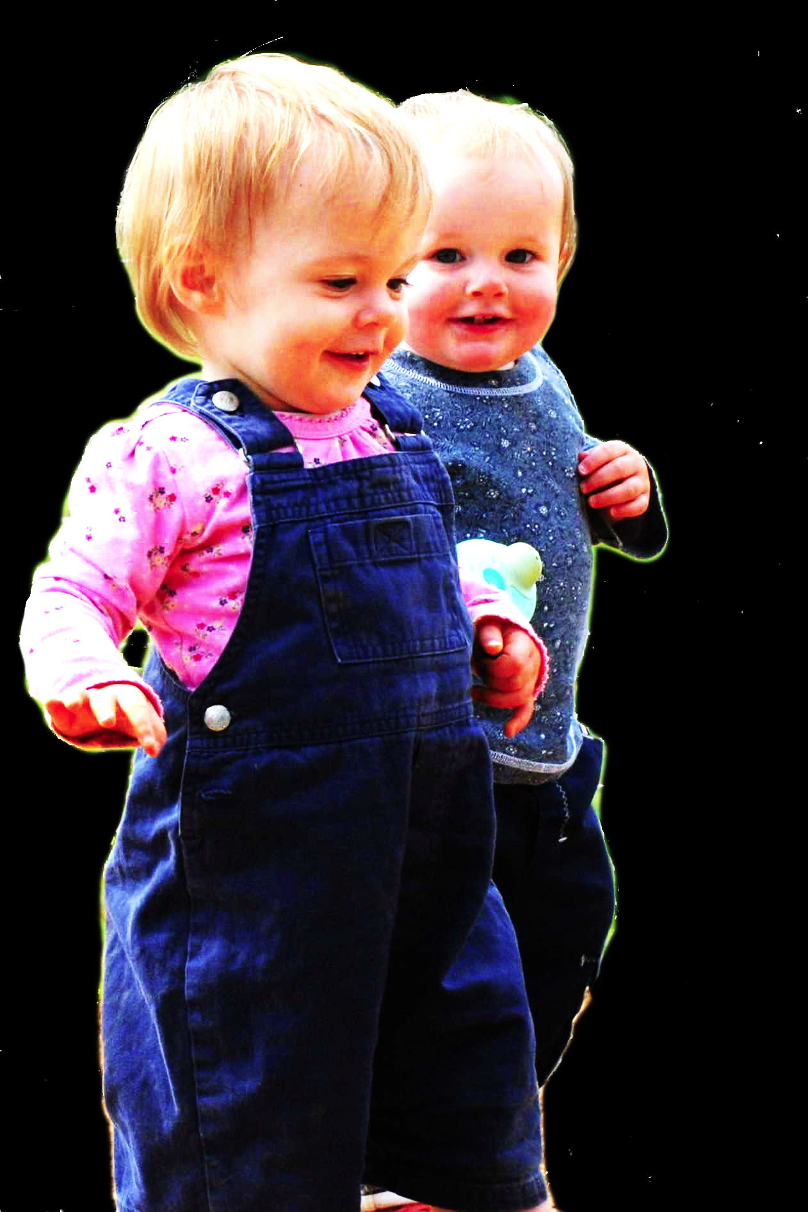
challenge
Explain the emergence, in evolution or development, of sophisticated forms of social cognition.
conjecture
The existence of abilities to engage in joint action partially explains how sophisticated forms of social cognition emerge in evolution or development (or both)
question
Given the conjecture, what could joint action be?

Slide 61
Goal-directed joint action: an event with two or more agents which, taken as a whole, is directed to a goal.
G is a distributive goal: it is an outcome to which each agent’s activities are individually directed and it is possible that: all agents succeed relative to this outcome.
G is a shared goal
G is a collective goal
(a) it is a distributive goal;
(b) the agents’ activities are coordinated; and
(c) coordination of this type would normally facilitate occurrences of outcomes of this type.
Each agent expects each of the other agents to perform activities directed to the goal.
Each agent expects the goal to occur as a common effect of all their goal-directed actions.

Slide 62


Slide 63

joint action &
knowing
others’
minds
Notes:
This is an overview of the project and its aims

Slide 64
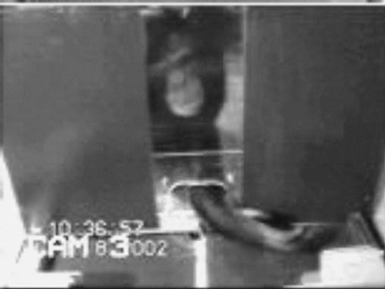
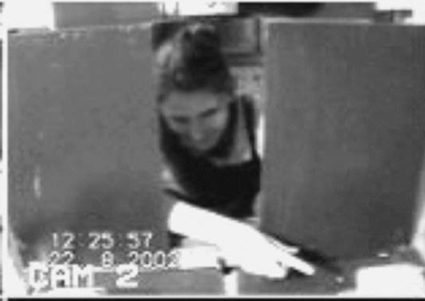
failed reach
point
source: Hare & Tomasello (2004)
Notes:
this illustrates problem of identifying particular goals of action

Slide 65
The problem of opaque means

Slide 66
The problem of false belief

Slide 67
your-goal-is-my-goal

Slide 68
your-goal-is-my-goal
1. We are about to engage in some joint action* or other
2. I am not about to change my goal.
Therefore:
3. Your actions also will be directed to this goal.
[*in at least the minimal sense associated with distributive goals]

Slide 69
failed reach
point
source: Hare & Tomasello (2004)

Slide 70
failed reach
point
source: Hare & Tomasello (2004)
“to understand pointing, the subject needs to understand more than the individual goal-directed behaviour. She needs to understand that ... the other attempts to communicate to her ... and ... the communicative intention behind the gesture”
(Moll & Tomsello 2007)

Slide 71
failed reach
point
source: Hare & Tomasello (2004)
“to understand pointing, the subject needs to understand more than the individual goal-directed behaviour. She needs to understand that ... the other attempts to communicate to her ... and ... the communicative intention behind the gesture”
(Moll & Tomsello 2007)

Slide 72
Csibra’s ‘two stances’:
Teleological and referential action interpretation ‘rely on different kinds of action understanding’
These are initially two distinct ‘action interpretation systems’ and they come together later in development
Csibra (2003, p. 456)

Slide 73
minimal theory of mind cognition
joint action (ability to share goals)
understanding communicative intent
other stuff
communication by language
other stuff
full-blown theory of mind cognition

Slide 75
Joint action:
an event with two or more agents (Ludwig 2007)
Goal-directed joint action:
a joint action which, taken as a whole, is directed to a goal
Nora’s shooting
Fred’s death
Olive’s shooting
Fred’s killing

Slide 76
What is the relation between an action and the goal (or goals) to which it is directed?

Slide 77
What is the relation between an action and the goal (or goals) to which it is directed?

Slide 78
What is the relation between an action and the goal (or goals) to which it is directed?
out
out
act
out
out

Slide 79
What is the relation between an action and the goal (or goals) to which it is directed?
out
out
act
(goal)
out
out

Slide 80
What is the relation between an action and the goal (or goals) to which it is directed?
out
out
act
represents
coordinates
(goal)
out
intention or other goal-state
out

Slide 81
What is the relation between an action and the goal (or goals) to which it is directed?
teleological function
out
out
act
represents
coordinates
out
intention or other goal-state
out

Slide 82
What is the relation between an action and the goal (or goals) to which it is directed?
teleological function
out
out
act
represents
coordinates
out
intention or other goal-state
It is possible to represent goal-directed actions without representing intentions.
out

Slide 83
out
out
act
out
out

Slide 84
Goal-directed joint action: an event with two or more agents which, taken as a whole, is directed to a goal.
out
out
act
out
out

Slide 86
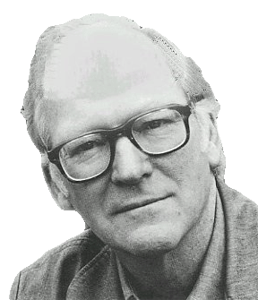
“We are stuck with our two main ways of describing and explaining things, one which treats objects and events as mindless, and the other which treats objects and events as having propositional attitudes. I see no way of bridging the gap by introducing an intermediate vocabulary.”
(Davidson 2003: 697)

Slide 87
“We are stuck with our two main ways of describing and explaining things, one which treats objects and events as mindless, and the other which treats objects and events as having propositional attitudes. I see no way of bridging the gap by introducing an intermediate vocabulary.”
(Davidson 2003: 697)

Slide 89

appendix
What could infants, chimps and scrub-jays represent that would enable them, within limits, to track others’ perceptions, knowledge, beliefs and other propositional attitudes?

Slide 90




Intentional relation
e.g. She is interested in that chocolate
e.g. She is smiling at me
Propositional attitude
e.g. She believes that the chocolate is in that cupboard

Slide 91

Your field = a set of objects related to you by proximity, orientation, lighting and other factors
You encounter an object = it is in your field
You register an object at a location = you most recently encountered the object at that location

Slide 92
Your field = a set of objects related to you by proximity, orientation, lighting and other factors
You encounter an object = it is in your field
You register an object at a location = you most recently encountered the object at that location
proximity
orientation
lighting
barriers
trajectory

Slide 93
Your field = a set of objects related to you by proximity, orientation, lighting and other factors
You encounter an object = it is in your field
You register an object at a location = you most recently encountered the object at that location
proximity
orientation
lighting
barriers
trajectory

Slide 94
Your field = a set of objects related to you by proximity, orientation, lighting and other factors
You encounter an object = it is in your field
You register an object at a location = you most recently encountered the object at that location
Principle 1: one can’t goal-directedly act on an object unless one has encountered it.
Principle 2: correct registration is a condition of successful action.
Principle 3: when an agent performs a goal-directed action and the goal specifies an object, the agent will act as if the object were actually in the location she registers it at.
proximity
orientation
lighting
barriers
trajectory

Slide 95
Your field = a set of objects related to you by proximity, orientation, lighting and other factors
You encounter an object = it is in your field
You register an object at a location = you most recently encountered the object at that location
Principle 1: one can’t goal-directedly act on an object unless one has encountered it.
Principle 2: correct registration is a condition of successful action.
Principle 3: when an agent performs a goal-directed action and the goal specifies an object, the agent will act as if the object were actually in the location she registers it at.
proximity
orientation
lighting
barriers
trajectory

Slide 96
Your field = a set of objects related to you by proximity, orientation, lighting and other factors
You encounter an object = it is in your field
You register an object at a location = you most recently encountered the object at that location
Principle 1: one can’t goal-directedly act on an object unless one has encountered it.
Principle 2: correct registration is a condition of successful action.
Principle 3: when an agent performs a goal-directed action and the goal specifies an object, the agent will act as if the object were actually in the location she registers it at.
proximity
orientation
lighting
barriers
trajectory

Slide 97
Your field = a set of objects related to you by proximity, orientation, lighting and other factors
You encounter an object = it is in your field
You register an object at a location = you most recently encountered the object at that location
Principle 1: one can’t goal-directedly act on an object unless one has encountered it.
Principle 2: correct registration is a condition of successful action.
Principle 3
proximity
orientation
lighting
barriers
trajectory

Slide 98
Your field = a set of objects related to you by proximity, orientation, lighting and other factors
You encounter an object = it is in your field
You register an object at a location = you most recently encountered the object at that location
Principle 1: one can’t goal-directedly act on an object unless one has encountered it.
Principle 2: correct registration is a condition of successful action.
Principle 3: when an agent performs a goal-directed action and the goal specifies an object, the agent will act as if the object were actually in the location she registers it at.
proximity
orientation
lighting
barriers
trajectory

Slide 99

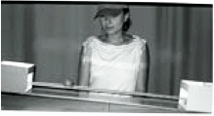
source Träuble, Marinovic, & Pauen (2010)

Slide 100
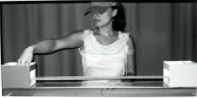
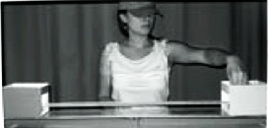
source Träuble, Marinovic, & Pauen (2010)

Slide 101
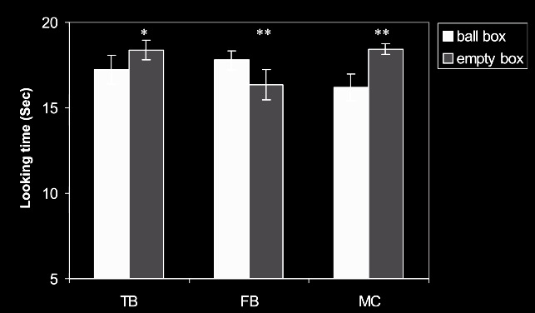
source Träuble, Marinovic, & Pauen (2010)

Slide 102
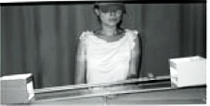
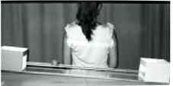
source Träuble, Marinovic, & Pauen (2010)

Slide 103
source Träuble, Marinovic, & Pauen (2010)

Slide 104
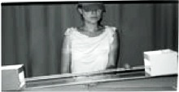
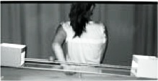
source Träuble, Marinovic, & Pauen (2010)

Slide 105
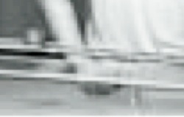
source Träuble, Marinovic, & Pauen (2010)

Slide 106
source Träuble, Marinovic, & Pauen (2010)

Slide 107
Your field = a set of objects related to you by proximity, orientation, lighting and other factors
You encounter an object = it is in your field
You register an object at a location = you most recently encountered the object at that location
Principle 1: one can’t goal-directedly act on an object unless one has encountered it.
Principle 2: correct registration is a condition of successful action.
Principle 3: when an agent performs a goal-directed action and the goal specifies an object, the agent will act as if the object were actually in the location she registers it at.
proximity
orientation
lighting
barriers
trajectory

Slide 108
Your field = a set of objects related to you by proximity, orientation, lighting and other factors
You encounter an object = it is in your field
You register an object at a location = you most recently encountered the object at that location
Principle 1: one can’t goal-directedly act on an object unless one has encountered it.
Principle 2: correct registration is a condition of successful action.
Principle 3: when an agent performs a goal-directed action and the goal specifies an object, the agent will act as if the object were actually in the location she registers it at.
proximity
orientation
lighting
barriers
trajectory

Slide 109
Principle 2: correct registration is a condition of successful action.
source Träuble, Marinovic, & Pauen (2010)

Slide 110
signature limits

Slide 111
1. Charly is Samantha
2. Mitch believes that Charly is in Baltimore
3. Mitch believes that Samantha is in Baltimore
(1) & (2) ⇒ (3)

Slide 112
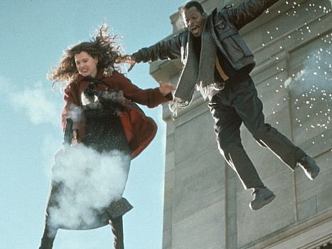
1. Charly is Samantha
2. Mitch believes that Charly is in Baltimore
3. Mitch believes that Samantha is in Baltimore
(1) & (2) ⇒ (3)

Slide 113
1. Charly is Samantha
2. Mitch believes that Charly is in Baltimore
3. Mitch believes that Samantha is in Baltimore
(1) & (2) ⇒ (3)
4. Mitch registers <Charly, Baltimore>
5. Mitch registers <Samantha, Baltimore>
(1) & (4) ⇒ (5)

Slide 114
False belief about location
False belief about identity
Subjects represent registration
Subjects represent beliefs
pass
fail
pass
pass

Slide 115
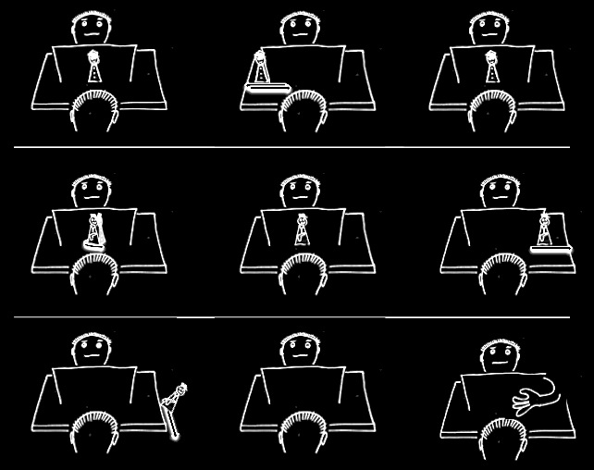

Slide 120
Which Joint Actions
Ground Social Cognition?
s.butterfill@warwick.ac.uk

Slide 121
Theory of mind abilities are widespread

Slide 122
Theory of mind abilities are widespread
18-month-olds point to inform, and predict actions based on false beliefs
(Liszkowski et al 2006)
(Onishi & Baillargeon 2005; Southgate et al 2007)

Slide 123
Theory of mind abilities are widespread
18-month-olds point to inform, and predict actions based on false beliefs
Scrub-jays selectively re-cache their food in ways that deprive competitors of knowledge of its location
(Liszkowski et al 2006)
(Onishi & Baillargeon 2005; Southgate et al 2007)
(Clayton, Dally & Emery 2007)

Slide 124
Theory of mind abilities are widespread
18-month-olds point to inform, and predict actions based on false beliefs
Scrub-jays selectively re-cache their food in ways that deprive competitors of knowledge of its location
Chimpanzees conceal their approach from a competitor’s view, and act in ways that are optimal given what another has seen
(Liszkowski et al 2006)
(Onishi & Baillargeon 2005; Southgate et al 2007)
(Clayton, Dally & Emery 2007)
(Hare, Call & Tomasello 2006)
(Hare, Call & Tomasello 2001)

Slide 125
Theory of mind abilities are widespread
18-month-olds point to inform, and predict actions based on false beliefs
Scrub-jays selectively re-cache their food in ways that deprive competitors of knowledge of its location
Chimpanzees conceal their approach from a competitor’s view, and act in ways that are optimal given what another has seen
(Liszkowski et al 2006)
(Onishi & Baillargeon 2005; Southgate et al 2007)
(Clayton, Dally & Emery 2007)
(Hare, Call & Tomasello 2006)
(Hare, Call & Tomasello 2001)

Slide 126
Theory of mind abilities are widespread
18-month-olds point to inform, and predict actions based on false beliefs
Scrub-jays selectively re-cache their food in ways that deprive competitors of knowledge of its location
Chimpanzees conceal their approach from a competitor’s view, and act in ways that are optimal given what another has seen
(Liszkowski et al 2006)
(Onishi & Baillargeon 2005; Southgate et al 2007)
(Clayton, Dally & Emery 2007)
(Hare, Call & Tomasello 2006)
(Hare, Call & Tomasello 2001)

Slide 127
Theory of mind abilities are widespread
18-month-olds point to inform, and predict actions based on false beliefs
Scrub-jays selectively re-cache their food in ways that deprive competitors of knowledge of its location
Chimpanzees conceal their approach from a competitor’s view, and act in ways that are optimal given what another has seen
(Liszkowski et al 2006)
(Onishi & Baillargeon 2005; Southgate et al 2007)
What doinfants, chimps and scrub-jays represent that enables them, within limits, to track others’ perceptions, knowledge, beliefs and other propositional attitudes?
(Clayton, Dally & Emery 2007)
(Hare, Call & Tomasello 2006)
(Hare, Call & Tomasello 2001)

Slide 128
Theory of mind abilities are widespread
18-month-olds point to inform, and predict actions based on false beliefs
Scrub-jays selectively re-cache their food in ways that deprive competitors of knowledge of its location
Chimpanzees conceal their approach from a competitor’s view, and act in ways that are optimal given what another has seen
Representing perceptions, knowledge states and beliefs is hard

Slide 129
Theory of mind abilities are widespread
18-month-olds point to inform, and predict actions based on false beliefs
Scrub-jays selectively re-cache their food in ways that deprive competitors of knowledge of its location
Chimpanzees conceal their approach from a competitor’s view, and act in ways that are optimal given what another has seen
Representing perceptions, knowledge states and beliefs is hard, for it requires
(a) conceptual sophistication
- takes years to develop
- development tied to acquisition of executive function and language
- development facilitated by training and siblings

Slide 130
Theory of mind abilities are widespread
18-month-olds point to inform, and predict actions based on false beliefs
Scrub-jays selectively re-cache their food in ways that deprive competitors of knowledge of its location
Chimpanzees conceal their approach from a competitor’s view, and act in ways that are optimal given what another has seen
Representing perceptions, knowledge states and beliefs is hard, for it requires
(a) conceptual sophistication
- takes years to develop
- development tied to acquisition of executive function and language
- development facilitated by training and siblings
(b) scarce cognitive resources
- attention
- working memory

Slide 131
Theory of mind abilities are widespread
18-month-olds point to inform, and predict actions based on false beliefs
Scrub-jays selectively re-cache their food in ways that deprive competitors of knowledge of its location
Chimpanzees conceal their approach from a competitor’s view, and act in ways that are optimal given what another has seen
Representing perceptions, knowledge states and beliefs is hard, for it requires
(a) conceptual sophistication
- takes years to develop
- development tied to acquisition of executive function and language
- development facilitated by training and siblings
(b) scarce cognitive resources
- attention
- working memory

